Slide 1
Year goals
Use professional software development practices to reimplement the influential Ferguson et al., 2020¹ Covid model (“CovidSim”);
Code openly available on Github with extensive examples and detailed description of model assumptions;
Emphasis on sensitivity analyses;
Web-based interface to model.
¹Ferguson et al., 2020. Report 9: Impact of non-pharmaceutical interventions (NPIs) to reduce COVID-19 mortality and healthcare demand.

Slide 2
Why is this interesting?
The Ferguson et al., 2020 report was highly influential in convincing the UK government to go into a state of lockdown in March;
The c++ code / model received unfair criticism for software development practices given the imperative need for model-driven recommendations at the time;
Model continues to be used by government(s) and research groups.

Slide 3
Disclaimer: CovidSim
There is documentation out there explaining how the models work;
I haven’t looked at the code itself;
What follows are my best guesses at how the model works, informed by/ lifted-straight-from the documentation.

Slide 4
What sort of model is CovidSim?
Stochastic individual-based simulation of transmission dynamics;
Spatial model, incorporating relatively high resolution geographical information: where people live; where they work; and so on.
People can infect others in their household, or in places (workplaces, schools and so on); there is also a type of infection that happens outside these places that uses a gravity model (“community infection”); proportions of symptomatic individuals are age-dependent;
Within host dynamics: S-E-Ia-Is(various)-R framework, with stochastic transition rates;
Allows interventions, like school closure and reduction of social contains.

Slide 5
Components
1. Setting up population;
2. Infection spread: virus introduced and subsequent interpersonal viral transmission dynamics;
3. Within-host progression: individualistic disease status and progression of disease through stages;
4. Interventions.

Slide 6
1. Population: people
Country divided into cells then microcells (9 1kmx1km cells in each cell);
People are allocated to households within cells according to population density data;
People have age and other attributes (what are these other attributes?);
People interact with one another via “places” and via random social interactions governed by a spatial kernel (they don’t explicitly move between cells or microcells).

Slide 7
1. Population: places
People are assigned to places: households (HHs), schools and workplaces;
Census data used to define age-distribution of individuals in HHs and size of HHs;
Synthetic schools were generated according to local population density, data on average class size and staff-student ratios;
Data on distribution of workplace size was used to generate workplaces and commuting distance data was used to locate workplaces.
(Hospitals aren’t explicitly represented as places—rather, they are effectively states that an infected person goes into (like GPs).)

Slide 8
2. Infection spread
Infections can be seeded in many ways; one way is to seed according to population density;
Three transmission mechanisms:
  HH infections (just between family members);
  Non-HH place infections (for example, at work);
  Spatial infections (i.e. when travelling around).
Spatial infections are a different kettle of fish: since people are fixed to their cells, this mimics movement. The gravity kernel used to allocate infections from place A to place B depends both on spatial distance and population densities:
  (I think this is f(d) = 1 / (1 + (d /a)^b) which is then biased by pop densities¹)
Ferguson et al., Strategies for mitigating an influenza pandemic, 2006, Nature: supp info page 6 &
https://github.com/mrc-ide/covid-sim/blob/master/docs/inputs-and-outputs.md

Slide 9
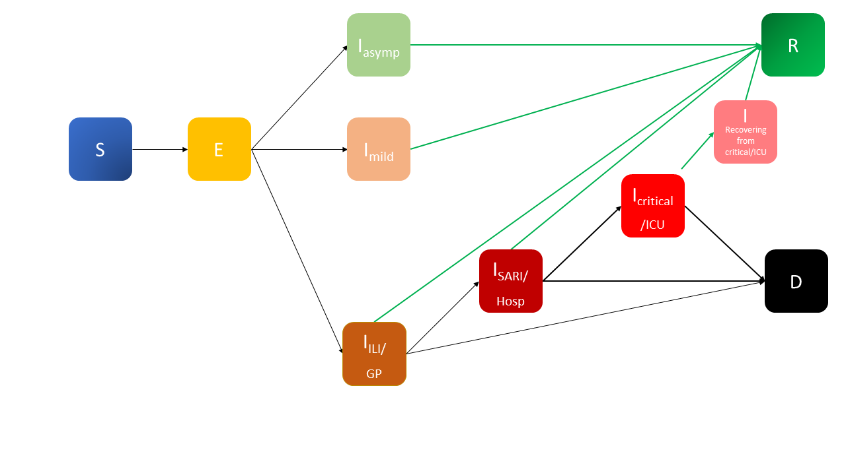
3. Within-host progression
Movement from E to infected states depends on age: time taken to move doesn’t but the prob of going into more infectious states depends on age.
More infectious
Severe acute respiratory infection (at hospitals)
Short-term (1-2 season immunity) but in light of REACT-2 study perhaps explore
Influenza-like illness
(care at GPs)
Symptomatics become hospitalised at certain age-dependent rate; hospitalised become critical at age-dependent rate; 50% of those critical will die. Some of non-critical patients also die (to match IFR)¹.
¹See Table 1 and “Disease progression and Healthcare Demand” in report 9.

Slide 10
4. Interventions (a few examples)
Case isolation at home;
Voluntary quarantine at home;
Social distancing for those over 70;
Social distancing of whole population;
Closure of schools and universities.

Slide 11
Key references
Report 9¹: good for context and provides a description of elements of the model;
“Strategies for mitigating an influenza pandemic^{”2:} good for looking into some details further, like spatial kernel (see supp. info.). Perhaps, beware that details of CovidSim may not be same as this;
Open-source repository for CovidSim³: has documentation on model and, of course, the code. It also has further references to other studies and the data used.

Slide 12
Key references
¹Ferguson et al., Report 9: Impact of non-pharmaceutical interventions (NPIs) to reduce COVID-19 mortality and healthcare demand, 2020;
²Ferguson et al., Strategies for mitigating an influenza pandemic, 2006, Nature;
CovidSim repo: https://github.com/mrc-ide/covid-sim.

Slide 13
Questions and comments
Parameter values should be non-hardcoded;
R0 is actually an input to the model: how it does this isn’t clear;
Allow model to accept data for other countries? (CovidSim allows this);
c++ or Python or bits of both? (model will be expensive, so perhaps will need some c++ for web app);
Web-app should do its best to hide code complexity and show how parameter changes affect results.

